Slide 1

Model Data Catalog
Initial Update for
Custom Named Entity Recognition (NER) Exploration
March 2, 2021

Slide 2
Why Use the NER model?
Identifying methods and topics within the abstract texts would assist searches and/or recommendations
Although long lists of models/methods are available, they are constantly evolving. We want to be able to identify new models as they are published.

Slide 3
Here

Slide 4
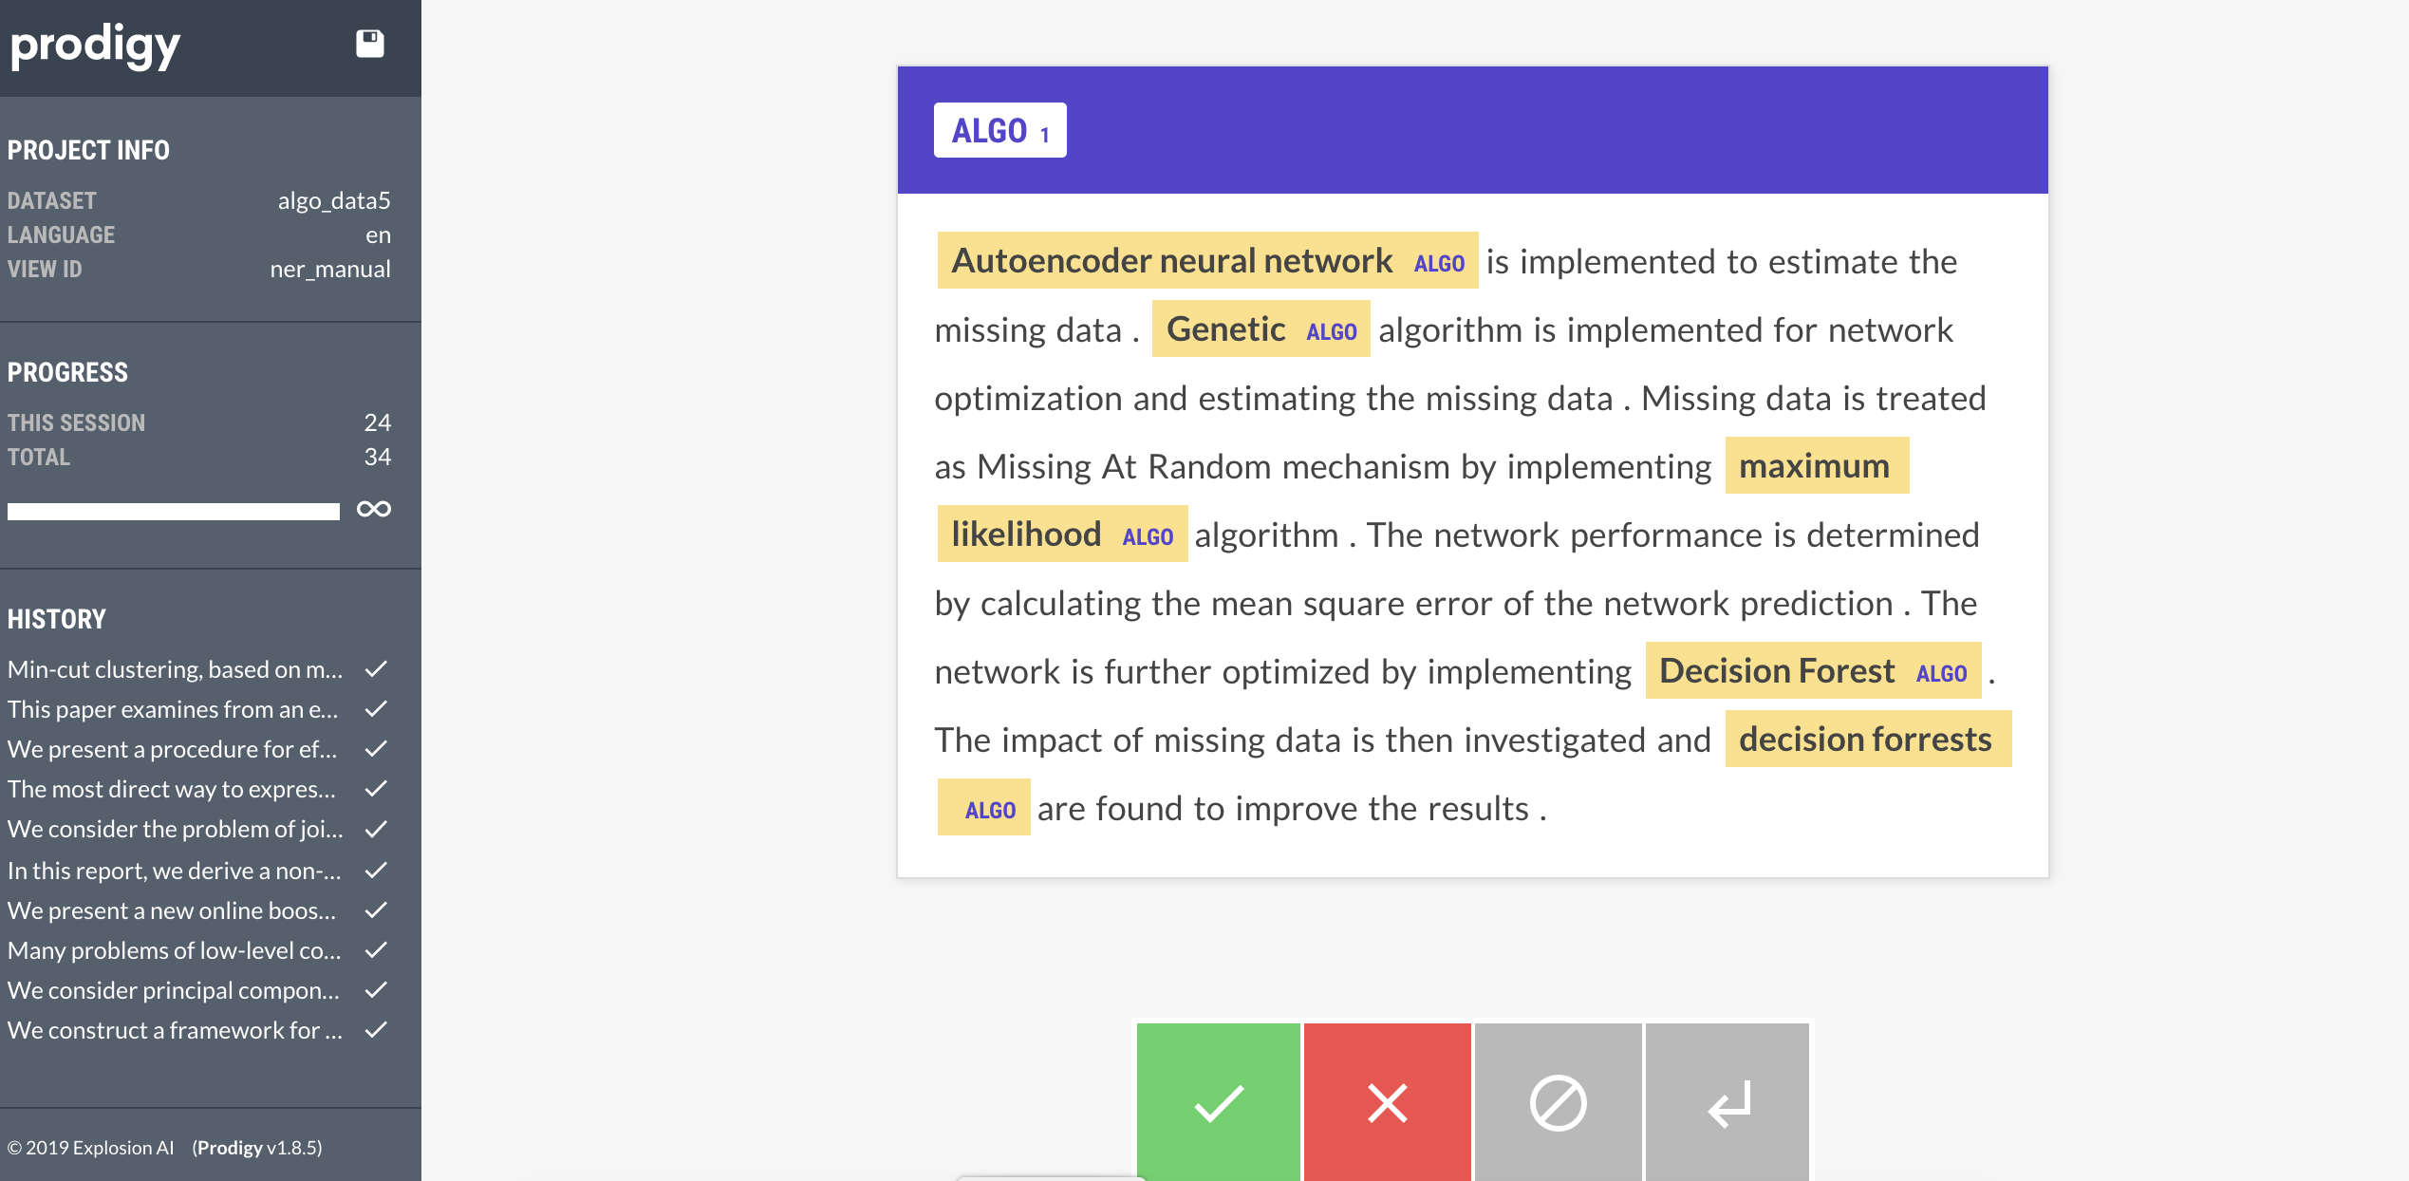
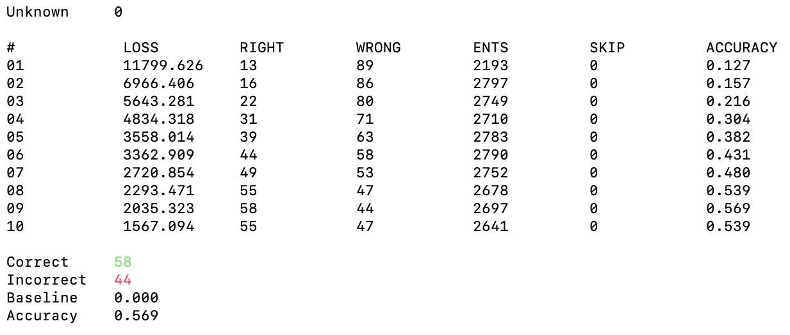
Tool: Spacy Prodigy

Slide 5
1st Attempt: METHOD/TASK/APPLICATION
Goal: Create NER model to identify the method, task, and application from the abstract or summary each catalog entry
Data:
20 Abstracts/summaries randomly selected from the Model Data Catalog
Entities (Text Labels):
Method: Machine learning or Statistical Model (random forest, neural network)
Task: Image classification, segmentation, etc.
Application: Tracking rainfall thresholds, predicting population, etc.

Slide 6
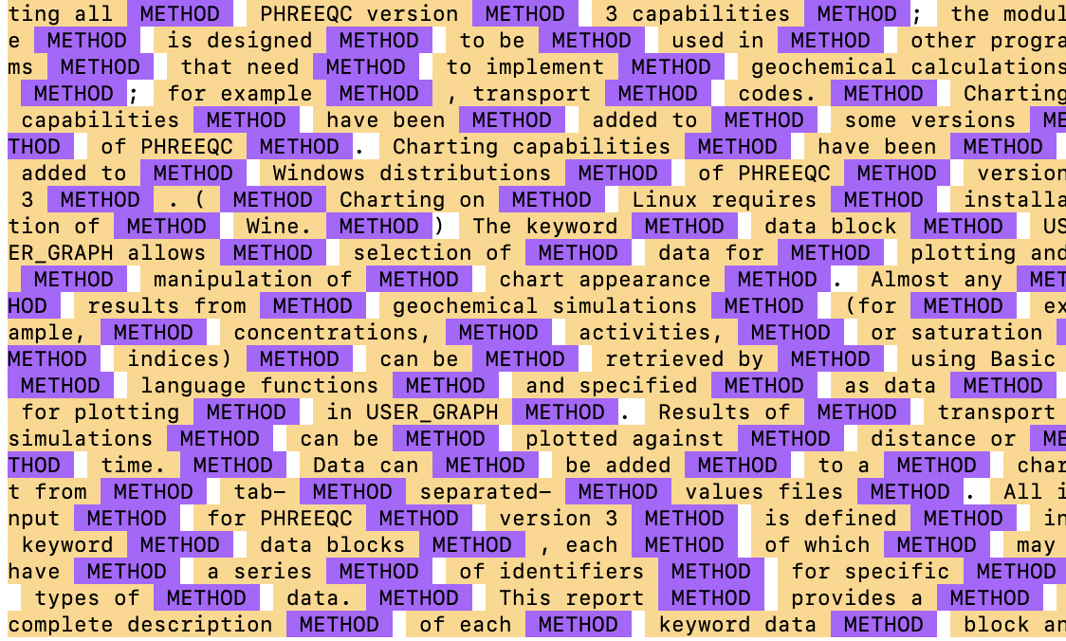
Challenges with First attempt:
Identifying the method in geological articles may require varied expertise. Some texts don’t have a method. [example]
There are mathematical, machine learning, statistical, and geological methods in the text.
The task and the method could overlap (e.g. A ground-motion prediction equation)
Applications often had long multi-word entities, but were often preceded by the word ‘provides.’
No luck with this attempt. Labeled everything – Decided to narrow down entities.

Slide 7
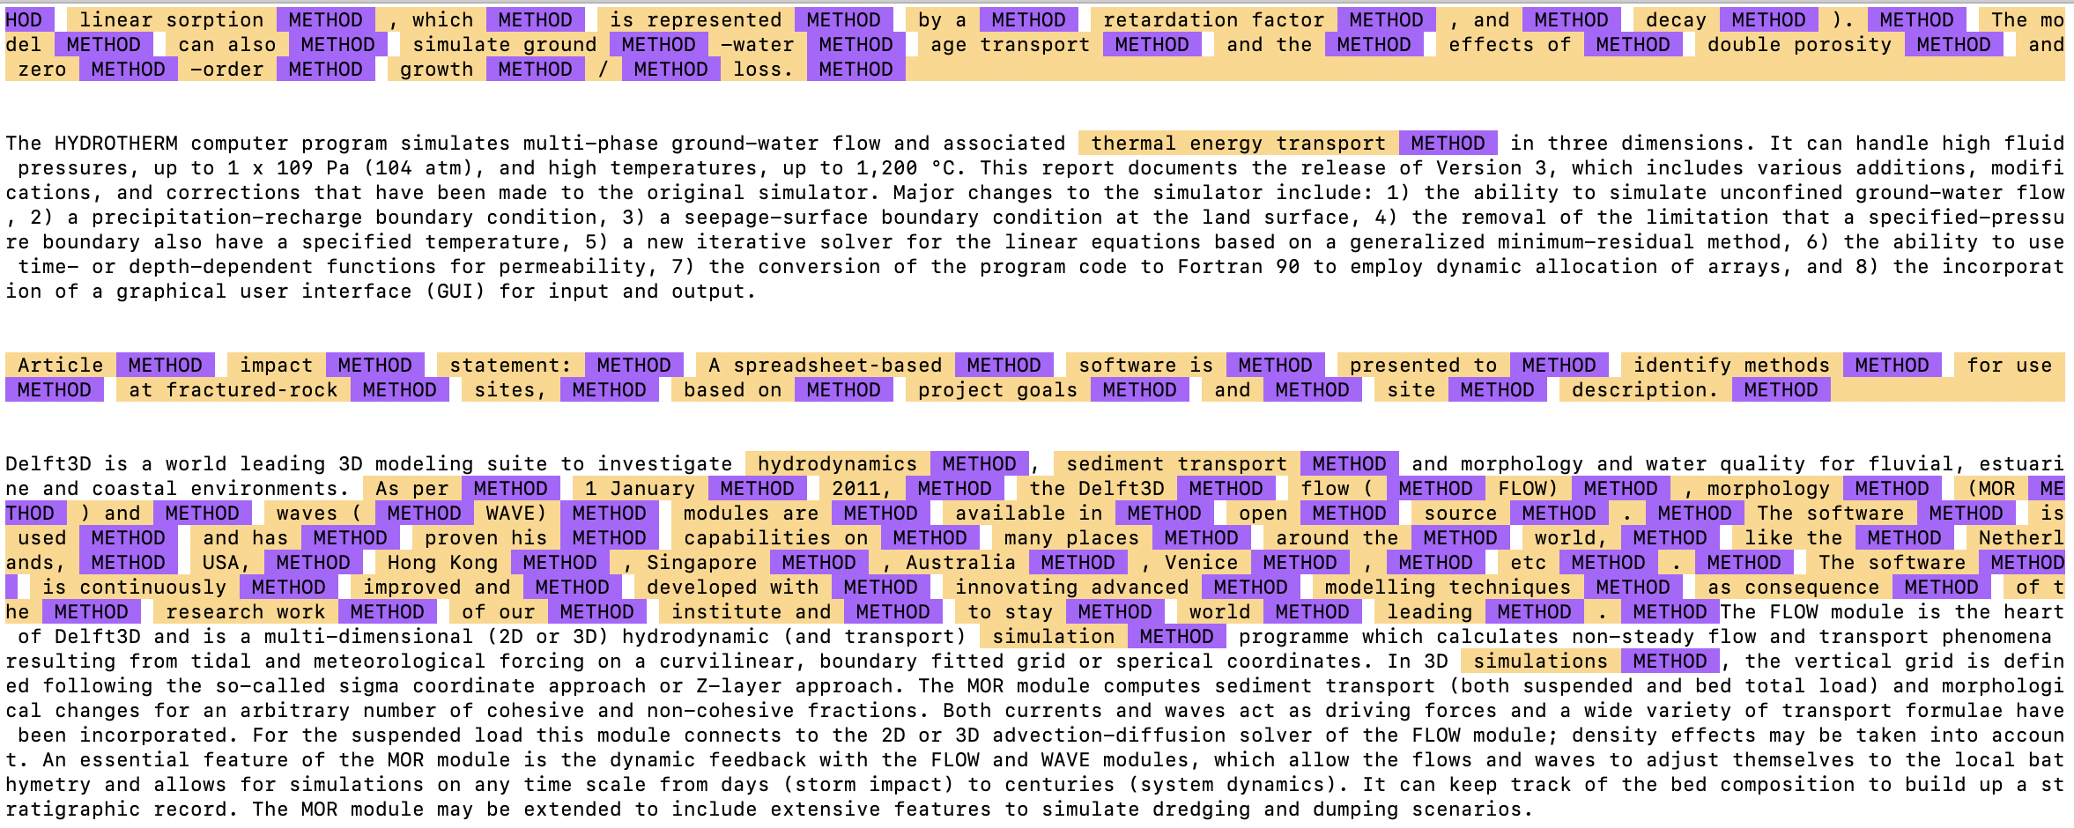
2nd Attempt: ALL METHODS
Goal: Create NER model to identify the method from the abstract or summary each catalog entry
Data:
40 Abstracts/summaries randomly selected from the Model Data Catalog
Entities (Text Labels):
Method: Machine learning, Statistical, OR Geological Model (random forest, neural network, regression, thermal energy transport, etc.)
CHALLENGES: There were few ML entities to train on. GEO models are complex and became geological entities instead of geological model entities

Slide 8
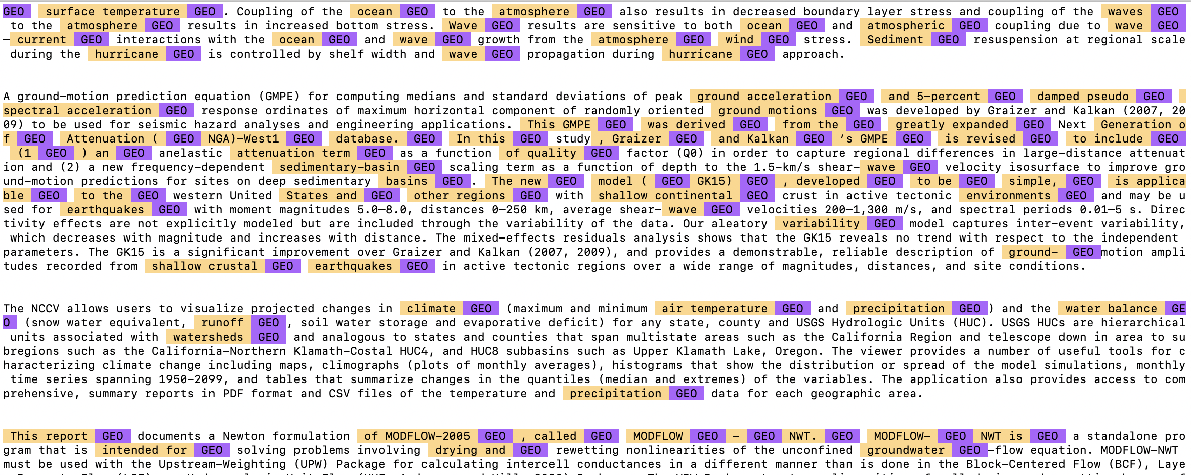
3rd Attempt: GEO METHODS
Goal: Create NER model to identify the geological method from the abstract or summary each catalog entry
Data:
40 Abstracts/summaries randomly selected from the Model Data Catalog
Entities (Text Labels):
Method: Geological Model (thermal energy transport, cellular automata land change model, etc.)
Challenges: Identifying the geological model, More like geological terms

Slide 9
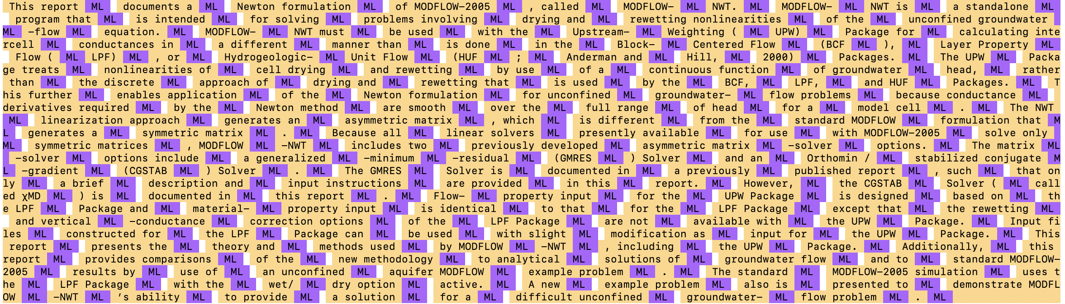
4th Attempt: Machine learning /STATS METHODS
Goal: Create NER model to identify the ML/Statistical method from the abstract or summary each catalog entry
Data:
40 Abstracts/summaries randomly selected from the Model Data Catalog
Entities (Text Labels):
Method: Machine learning, Statistical Model(random forest, neural network, regression)
Challenges: Not enough to train on. There were only a couple entities in all the texts.

Slide 10
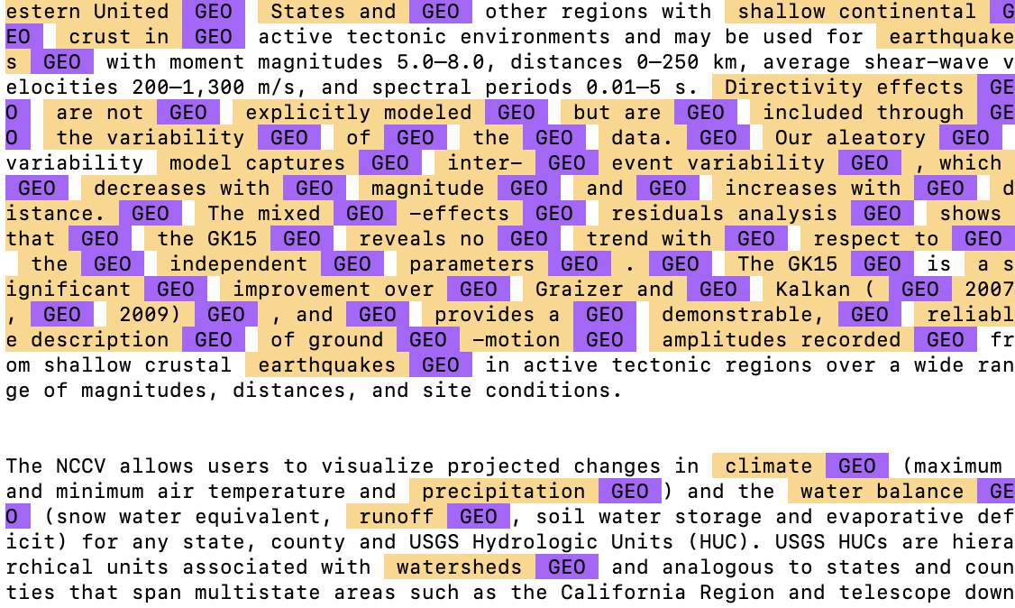
5th Attempt: GEO METHODS
Goal: Make an improved NER model to identify the geological method from the abstract or summary each catalog entry
Data:
40 Abstracts/summaries randomly selected from the Model Data Catalog
Entities (Text Labels):
Method: Geological Model (thermal energy transport, cellular automata land change model, etc.)
Challenges: Conflicting entity error- Take notes on labeling!!!

Slide 11
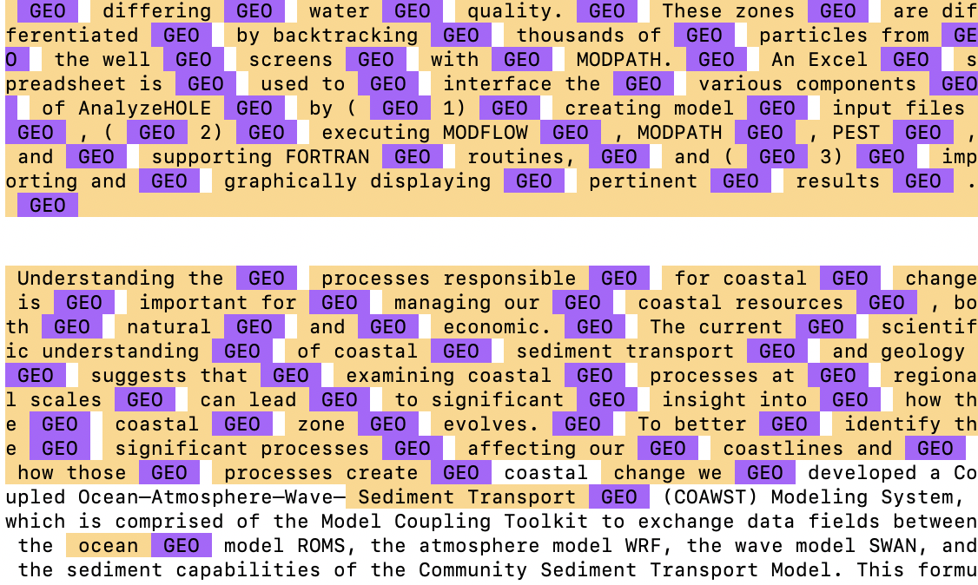
6th Attempt: Using ‘model’
Goal: Create NER model to identify the Methods by words before ‘model’ ‘algorithm’ ‘prediction’ ‘analysis’ ‘simulation tool’ ‘modeling technique’ or ‘submodel’
Data:
40 Abstracts/summaries randomly selected from the Model Data Catalog
Entities (Text Labels):
Method: Machine learning, Statistical Model(random forest, neural network, regression)
Challenges: Not enough to train on.

Slide 12
7th Attempt: Machine learning method (transfer learning)
Goal: Create NER model to identify the ML/Statistical method from the abstract or summary each catalog entry
Data:
3100 Abstracts/summaries relating to ml randomly selected from the ARXIV
Entities (Text Labels):
Method: Machine learning, Statistical Model(random forest, neural network, regression)
Challenges: take a long time to pretrain so many texts

Slide 13
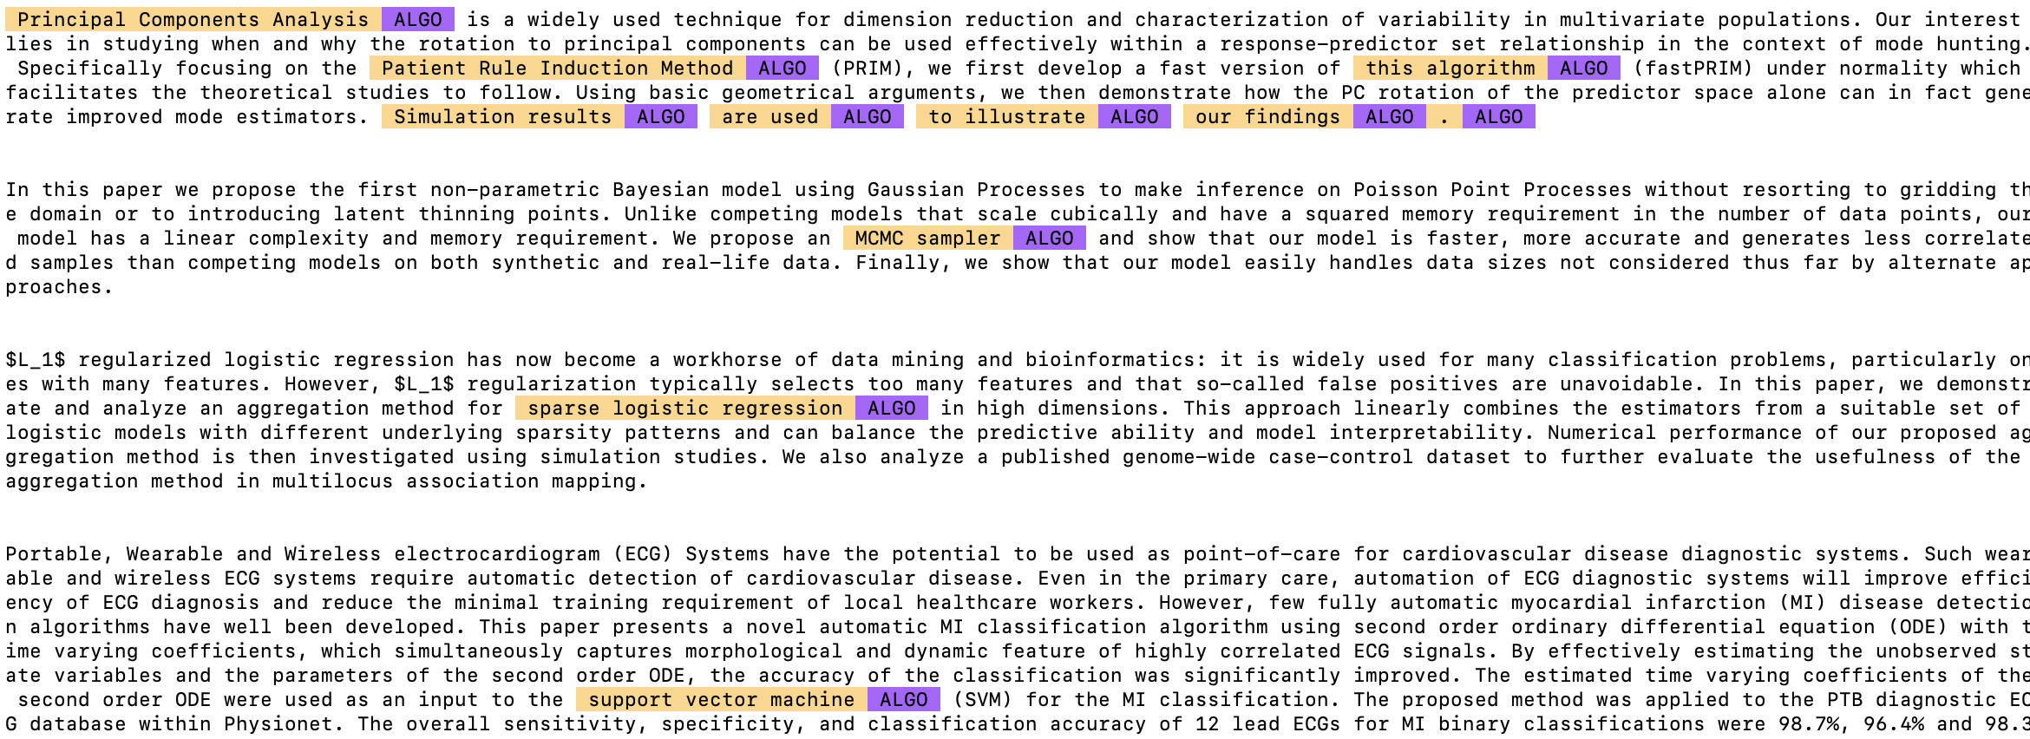
Labeling on arxiv

Slide 14
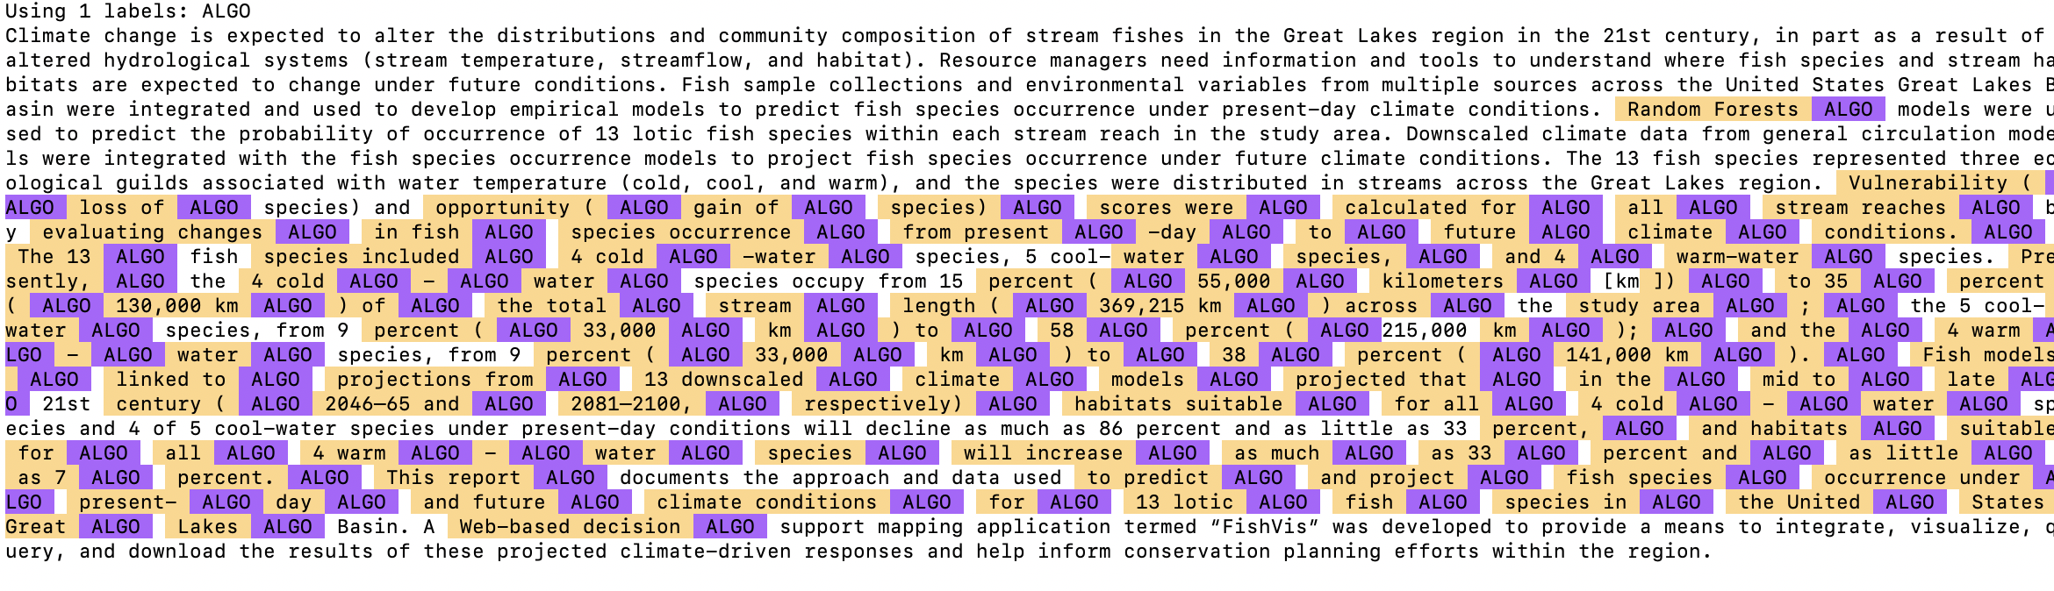
Didn’t quite transfer to model catalog

Slide 15
(ERROR on 8th) 9th attempt: ML METHOD (transfer learning)
Goal: Create NER model to identify the ML/Statistical method from the abstract or summary each catalog entry
Data:
324 Abstracts/summaries relating to ml randomly selected from the ARXIV (didn’t need such a large sample as in 7th attempt)
Entities (Text Labels):
Method: Machine learning, Statistical Model(random forest, neural network, regression)
Challenges: make-gold made it worse and couldn’t go back to original model

Slide 16
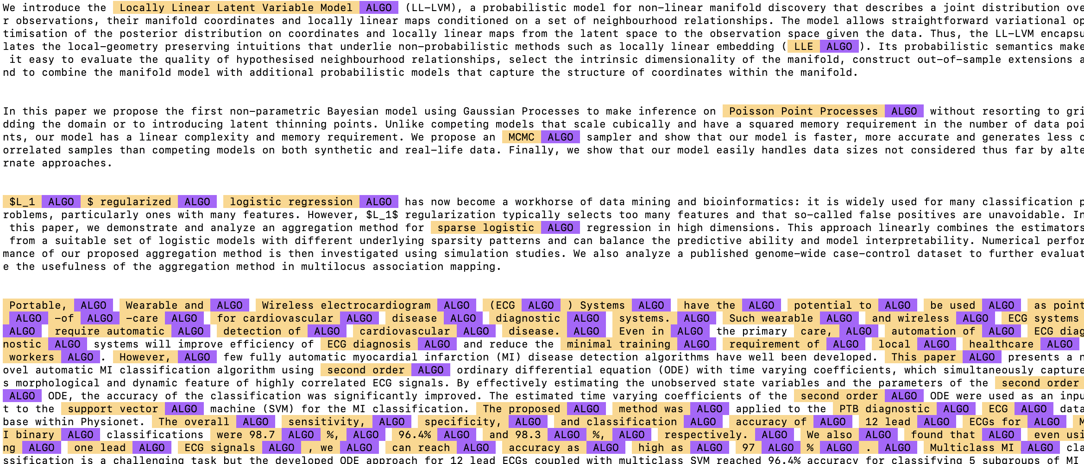
Labeling on arxiv

Slide 17
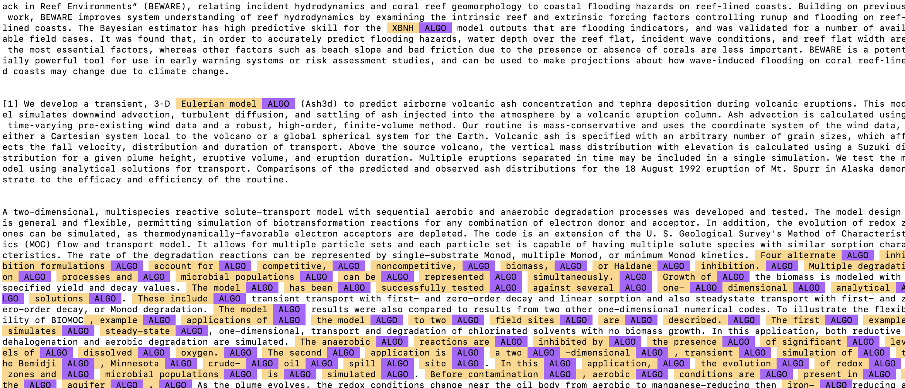
Labeling on Model Catalog text

Slide 18
10th /11th Attempt: ML METHOD (transfer learning)
Goal: Create NER model to identify the ML/Statistical method from the abstract or summary each catalog entry
Data:
324 Abstracts/summaries relating to ml randomly selected from the ARXIV
Entities (Text Labels):
Method: Machine learning, Statistical Model(random forest, neural network, regression)
Challenges: Saved the original model. Again, got worse on make-gold. Didn’t improve model, but well-documented labels.

Slide 19
Observations so far…
Data: Some texts are labeled with ‘abstract’, others with ‘introduction’, ‘summary’, or ‘model overview and system requirements’. Is the abstract text always available in metadata?
Many texts reference other models (future work, comparisons, etc.) or use an ensemble of models (wind, wave, current, etc.)
Model Data Catalog has a lot of waterflow, watershed, water balance and convection models which are mostly mathematical (not machine learning methods)
Geological method labels evolved into geology nouns (volcano, stream, ocean, reservoir, etc.) Challenging to identify geological models without domain knowledge. Examples of ‘geo methods’ on next slide.

Slide 20
Example text for geo ‘methods’
Earthquakes (subduction zone, ground motion prediction)
Flooding/Waves
Migration cycle
Reservoir water balance
Aqueous geochemical model
Limit-equilibrium analysis, slope-stability analysis, slope stability
Hydrodynamics, Vertical Fluid Flow
solute transport, thermal energy transport, sediment transport
watersheds and redevelopment
water quality
evolution of coastal zone
climate change
digital elevation model, diffuse layer model
3D method of columns (landslides)
Vertical fluid flow (seepage flux)
“building a 3D domain”
Aqueous geochemical calculations
(1D) transport calculations
Ion aqueous model, Pitzer aqueous model
Peng-Robinson equation (for gas solubility)
Transport simulations, geochemical simulations, heat transport equations,
Flow and transport: aquifer, pollutants, sediment, solute, heat, thermal energy,
Population (density, estimation, prediction, etc.)
Water-balance model, water balance modeling,

Slide 21
OTHER Lessons learned…
Define the exact type of methods and models to be labeled. You want to think as little as possible when manually labeling.
Make rules early and document: e.g. include the word ‘model’ or ‘algorithm’ or only the words describing the model. Take notes for consistency between seeding, manual training, and make-gold (corrections).
Difficulty implementing patterns: Patterns seed the NER model. It can save time by pre-labeling the text. Only need to seed once and can save the patterns for all texts. Work in progress.
Be sure to train for bad examples as well as the correct labels. Use the ignore button sparingly.
Transfer learning (training on arxiv) may be the way to go since the model catalog is relatively small.
Developing a custom ner model is labor intensive, weigh the benefits!

Slide 22
Questions?

Slide 23
No model?
The North American Breeding Bird Survey (BBS) is the primary source for critical quantitative data to evaluate the status of continental bird species, keeping common birds common and helping fuel a $75 billion wildlife watching industry. Each year thousands of citizen scientists skilled in avian identification collect data on BBS routes throughout North America allowing us to better understand bird population changes and manage them. The USGS Patuxent Wildlife Research Center, Environment and Climate Change Canada, and the Mexican National Commission for the Knowledge and Use of Biodiversity jointly coordinate the program, which provides reliable population data and trend analyses on more than 500 bird species. [back to slide]

Slide 24
Along the Santa Clara River in California, populations of the federally and state-listed Least Bell's Vireo (Vireo bellii pusillus) are recovering from near extirpation. Habitat protection and restoration, as well as controlling rates of brood parasitism, are thought to be the primary drivers of this recovery. Continuing successful management of this population faces multiple challenges due to the highly dynamic and unpredictable nature of the system, lack of clearly defined and measurable recovery criteria, parametric and stochastic uncertainty, and data limitations. Many of these management challenges are not unique to Least Bell's Vireo and require careful balancing of limited resources into the future. We developed a decision support tool as a user interface for exploring the underlying uncertainty in a population viability analysis under an array of different management scenarios. The tool was designed to assist with the planning and coordination between conservation partners in the region in three distinct aspects of the decision-making process: defining the problem and setting clear goals and objectives, exploring the consequences of potential alternative actions, and identifying criteria for ongoing evaluation and monitoring. The general framework for the design of this decision support tool is broadly applicable to many management and decision-making scenarios that share these common challenges. [back to slide]

